Slide 1
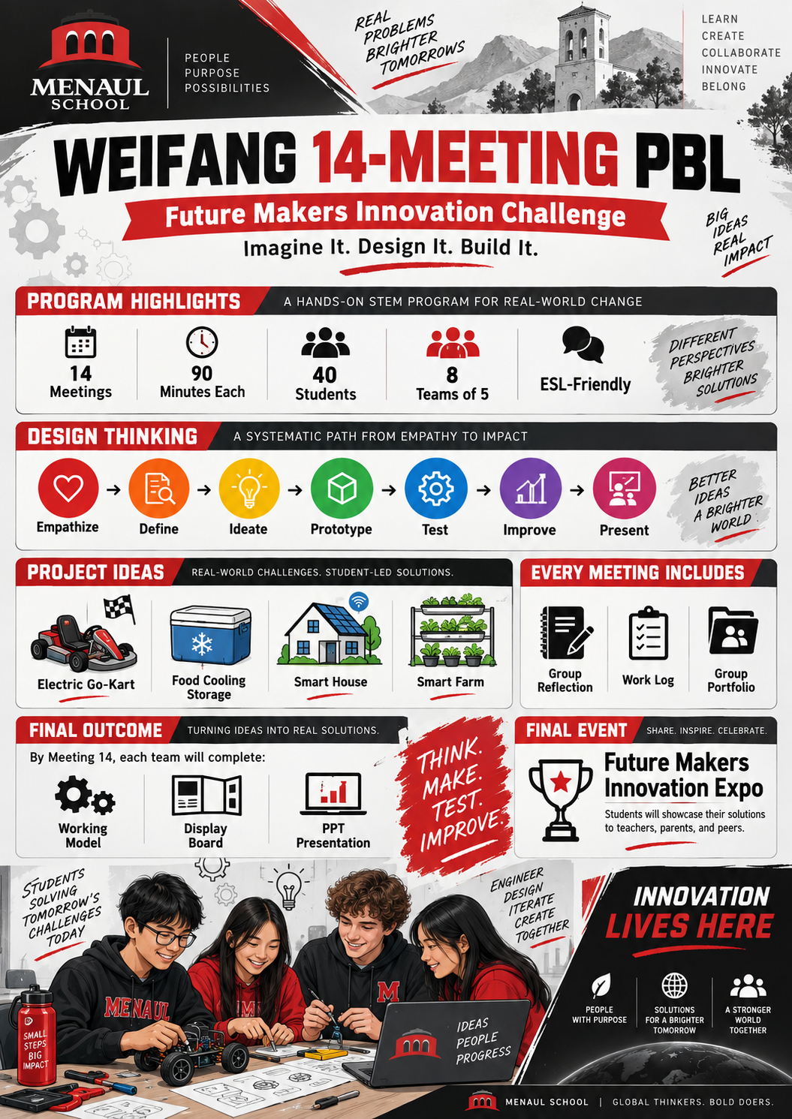

WEIFANG
14-MEETING PBL
Future Makers Innovation Challenge
Imagine It. Design It. Build It.
14 Meetings
90 Minutes Each
40 Students
A complete teacher/student PPT for the full PBL cycle

Slide 2
The Big Picture
Students solve real problems through design thinking
Driving Question
How might we design and build a solution that makes everyday life smarter, safer, healthier, or more sustainable?
👥
🧭
🛠️
🎤
8 teams of 5
Design Thinking
Working Model
Innovation Expo
Students work in small innovation teams.
Empathize, define, ideate, prototype, test, improve, present.
Each team builds and tests a functional prototype.
Students showcase to teachers, parents, and peers.
MENAUL SCHOOL | Future Makers Innovation Challenge
2

Slide 3
Design Thinking Journey
A simple cycle for ESL learners
Think of this project as a journey from a problem to a tested solution.
❤️
🔎
💡
📦
⚙️
📈
🎤
→
→
→
→
→
→
Empathize
Define
Ideate
Prototype
Test
Improve
Present
Who has the problem?
What is the exact problem?
What solutions are possible?
Can we build it?
Does it work?
What should change?
How can we share it?
Core Mindset
Think → Make → Test → Learn → Improve
Good designers use evidence. They do not guess.
MENAUL SCHOOL | Future Makers Innovation Challenge
3

Slide 4
Team Setup for 40 Students
8 teams of 5 students
1
Project Manager
Keeps the team on task and checks deadlines.
2
Design Engineer
Leads sketches, measurements, and design decisions.
3
Build Engineer
Leads safe construction and assembly.
4
Research & Testing Leader
Collects data and records testing evidence.
5
Communication & Marketing Leader
Manages portfolio, photos, display board and pitch.
Tip: Rotate roles during the project so students practise different skills.
MENAUL SCHOOL | Future Makers Innovation Challenge
4

Slide 5
Project Choices
Teacher-approved challenges
🏎️
Electric Go-Kart
❄️
Food Cooling Storage
Design a small electric vehicle that is safe, efficient, and easy to control.
Keep food cool when electricity or refrigeration is limited.
🏠
Smart House
🌱
Smart Farm
Use sensors and automation to make a home safer and more efficient.
Help farmers save water, energy, or labour using simple technology.
Choose a project that is interesting, realistic, safe, and testable in 14 meetings.
MENAUL SCHOOL | Future Makers Innovation Challenge
5

Slide 6
Every Meeting Includes Evidence
Reflection, work log and portfolio
📝
📒
📁
Group Reflection
Individual Work Log
Group Portfolio
One per team, every meeting. What did we complete? What problem did we meet? What is our next step?
One short entry per student. What did I do? What did I learn? What is my next step?
Collect research, sketches, photos, testing data, improvements, PPT and final evidence.
No evidence = no process. Students must show how their idea changed over time.
MENAUL SCHOOL | Future Makers Innovation Challenge
6

Slide 7
14-Meeting Roadmap
From launch to innovation expo
1
2
3
4
5
6
7
→
→
→
→
→
→
Launch
Empathize
Define
Ideate
Select
Plan
Build 1
8
9
10
11
12
13
14
→
→
→
→
→
→
Build 2
Test
Improve
Finalize
Market
Prepare
Expo
At the end of every meeting: group reflection + individual work log + portfolio update
MENAUL SCHOOL | Future Makers Innovation Challenge
7

Slide 8
Meeting 1: Project Launch
Project Launch
1
TODAY’S GOAL
Understand the challenge, form teams, choose a project and start the portfolio.
Class Activities
Team Deliverables
🚀
Introduce PBL and Design Thinking
Show example inventions/prototypes
Form 8 teams of 5 students
Choose one teacher-approved challenge
Team name and members
Initial team roles
Selected project challenge
First problem idea
PROJECT LAUNCH
90 minutes
TEACHER MOVE
EXIT REFLECTION
Team evidence
+ reflection
Make the project feel exciting and real. Show what students will build by Meeting 14.
What did we finish? What problem did we meet? What is our next step?
Update: group reflection + individual work log
MENAUL SCHOOL | Future Makers Innovation Challenge
8

Slide 9
Meeting 2: Understand the User
Empathize
2
TODAY’S GOAL
Find out who has the problem and what they really need.
Class Activities
Team Deliverables
👥
Identify possible users
Do simple interviews/surveys
Observe or research the problem
Collect useful evidence
User profile
Research notes
Interview/survey evidence
Photos/screenshots if useful
EMPATHIZE
90 minutes
TEACHER MOVE
EXIT REFLECTION
Team evidence
+ reflection
Push students to ask: Who has this problem? Why does it matter?
What did we finish? What problem did we meet? What is our next step?
Update: group reflection + individual work log
MENAUL SCHOOL | Future Makers Innovation Challenge
9

Slide 10
Meeting 3: Write the Problem Statement
Define
3
TODAY’S GOAL
Turn research into a clear problem statement and success criteria.
Class Activities
Team Deliverables
🎯
Sort research findings
Write user needs
Define the exact problem
Create 3–5 success criteria
Problem statement
User needs list
Success criteria
Updated portfolio page
DEFINE
90 minutes
TEACHER MOVE
EXIT REFLECTION
Team evidence
+ reflection
Give sentence frames so ESL students can write clearly.
What did we finish? What problem did we meet? What is our next step?
Update: group reflection + individual work log
MENAUL SCHOOL | Future Makers Innovation Challenge
10

Slide 11
Meeting 4: Generate Many Ideas
Ideate
4
TODAY’S GOAL
Create several possible solutions before choosing one.
Class Activities
Team Deliverables
💡
Crazy 8 sketches
Team brainstorming
Combine ideas
Label sketches clearly
At least 3 possible solutions
Brainstorming sheet
Sketches with labels
Pros and cons notes
IDEATE
90 minutes
TEACHER MOVE
EXIT REFLECTION
Team evidence
+ reflection
Protect creative thinking: no idea-killing too early.
What did we finish? What problem did we meet? What is our next step?
Update: group reflection + individual work log
MENAUL SCHOOL | Future Makers Innovation Challenge
11

Slide 12
Meeting 5: Choose the Best Design
Select Best Solution
5
TODAY’S GOAL
Compare ideas and select a realistic, safe and testable solution.
Class Activities
Team Deliverables
✅
Use a decision matrix
Compare ideas with criteria
Discuss limits and risks
Choose one final concept
Decision matrix
Chosen design
Reason for choice
Final concept sketch
SELECT BEST SOLUTION
90 minutes
TEACHER MOVE
EXIT REFLECTION
Team evidence
+ reflection
Remind teams: best does not mean most complicated.
What did we finish? What problem did we meet? What is our next step?
Update: group reflection + individual work log
MENAUL SCHOOL | Future Makers Innovation Challenge
12

Slide 13
Meeting 6: Plan Before Building
Engineering Plan
6
TODAY’S GOAL
Prepare drawings, materials, safety rules and task responsibilities.
Class Activities
Team Deliverables
📐
Create detailed design sketch
Make materials list
Plan build sequence
Complete safety checklist
Engineering plan
Bill of Materials
Safety plan
Task division
ENGINEERING PLAN
90 minutes
TEACHER MOVE
EXIT REFLECTION
Team evidence
+ reflection
Do a safety mini-briefing before any tool use.
What did we finish? What problem did we meet? What is our next step?
Update: group reflection + individual work log
MENAUL SCHOOL | Future Makers Innovation Challenge
13

Slide 14
Meeting 7: Build Prototype 1
Prototype
7
TODAY’S GOAL
Start building the first version of the working model.
Class Activities
Team Deliverables
🛠️
Set up materials
Begin construction
Measure and assemble carefully
Photograph progress
Prototype progress
Construction photos
Problem notes
Updated portfolio
PROTOTYPE
90 minutes
TEACHER MOVE
EXIT REFLECTION
Team evidence
+ reflection
Coach teams to build safely and record evidence as they work.
What did we finish? What problem did we meet? What is our next step?
Update: group reflection + individual work log
MENAUL SCHOOL | Future Makers Innovation Challenge
14

Slide 15
Meeting 8: Build and Check
Prototype
8
TODAY’S GOAL
Continue building and pause to check what is working and what needs changing.
Class Activities
Team Deliverables
🔧
Continue construction
STOP–CHECK–THINK review
Adjust the plan if needed
Prepare for first test
Prototype Version 1
Updated design notes
Progress photos
Build problems list
PROTOTYPE
90 minutes
TEACHER MOVE
EXIT REFLECTION
Team evidence
+ reflection
Use the midpoint pause to prevent teams from building blindly.
What did we finish? What problem did we meet? What is our next step?
Update: group reflection + individual work log
MENAUL SCHOOL | Future Makers Innovation Challenge
15

Slide 16
Meeting 9: Test the Prototype
Test
9
TODAY’S GOAL
Use evidence to find out if the prototype works.
Class Activities
Team Deliverables
⚙️
Create a simple testing plan
Run the test
Record measurements/results
Identify problems
Testing plan
Data table
Photos/videos
Problems identified
TEST
90 minutes
TEACHER MOVE
EXIT REFLECTION
Team evidence
+ reflection
Ask for measurable evidence: time, distance, temperature, response, or accuracy.
What did we finish? What problem did we meet? What is our next step?
Update: group reflection + individual work log
MENAUL SCHOOL | Future Makers Innovation Challenge
16

Slide 17
Meeting 10: Improve the Design
Improve
10
TODAY’S GOAL
Use testing results to make the model better.
Class Activities
Team Deliverables
📈
Analyze test results
Use Keep–Change–Add
Repair or redesign weak parts
Build Prototype Version 2
Improvement plan
Before/after evidence
Prototype Version 2
Reflection on changes
IMPROVE
90 minutes
TEACHER MOVE
EXIT REFLECTION
Team evidence
+ reflection
Make teams explain why they changed something.
What did we finish? What problem did we meet? What is our next step?
Update: group reflection + individual work log
MENAUL SCHOOL | Future Makers Innovation Challenge
17

Slide 18
Meeting 11: Final Engineering
Finalize
11
TODAY’S GOAL
Make the working model reliable, safe and ready for demonstration.
Class Activities
Team Deliverables
🏁
Strengthen the model
Check wiring/structure
Improve appearance
Conduct a final short test
Near-final working model
Final test evidence
Safety check
Model photos
FINALIZE
90 minutes
TEACHER MOVE
EXIT REFLECTION
Team evidence
+ reflection
Help teams simplify if needed. A reliable model is better than an unfinished complex one.
What did we finish? What problem did we meet? What is our next step?
Update: group reflection + individual work log
MENAUL SCHOOL | Future Makers Innovation Challenge
18

Slide 19
Meeting 12: Product Story and Marketing
Marketing
12
TODAY’S GOAL
Create a product identity and explain why the solution matters.
Class Activities
Team Deliverables
📣
Create product name and logo
Write slogan
Identify target user
Practise a 30-second pitch
Product name
Slogan
Target user
Elevator pitch
MARKETING
90 minutes
TEACHER MOVE
EXIT REFLECTION
Team evidence
+ reflection
Students should speak like young designers and entrepreneurs.
What did we finish? What problem did we meet? What is our next step?
Update: group reflection + individual work log
MENAUL SCHOOL | Future Makers Innovation Challenge
19

Slide 20
Meeting 13: Prepare the Exhibition
Prepare
13
TODAY’S GOAL
Complete the display board, PPT, portfolio and presentation rehearsal.
Class Activities
Team Deliverables
🖼️
Finish display board
Complete PPT slides
Organize portfolio
Rehearse presentation and demo
Final model
Display board
PPT presentation
Complete group portfolio
PREPARE
90 minutes
TEACHER MOVE
EXIT REFLECTION
Team evidence
+ reflection
Run a gallery walk rehearsal and give quick feedback.
What did we finish? What problem did we meet? What is our next step?
Update: group reflection + individual work log
MENAUL SCHOOL | Future Makers Innovation Challenge
20

Slide 21
Meeting 14: Future Makers Expo
Present
14
TODAY’S GOAL
Present the working model and design process to a real audience.
Class Activities
Team Deliverables
🎤
Set up exhibition booth
Present for 5–7 minutes
Demonstrate model
Answer questions
Working model
Display board
PPT presentation
Portfolio and work logs
PRESENT
90 minutes
TEACHER MOVE
EXIT REFLECTION
Team evidence
+ reflection
Celebrate process, learning, teamwork and improvement—not only the “best” model.
What did we finish? What problem did we meet? What is our next step?
Update: group reflection + individual work log
MENAUL SCHOOL | Future Makers Innovation Challenge
21

Slide 22
Assessment Rubric
Total: 100 points
What will students be assessed on?
Problem Identification & Research
10
Teamwork & Individual Contribution
10
Design Thinking Process
15
Work Logs & Reflections
10
Design & Creativity
10
Group Portfolio
5
Working Prototype
20
Display Board
5
Testing & Improvement
10
PPT & Final Presentation
5
Assessment should reward process, evidence, teamwork, testing, improvement and communication.
MENAUL SCHOOL | Future Makers Innovation Challenge
22

Slide 23
Future Makers Innovation Expo
How to attract parents and students
🎟️
Innovation Passport
💰
Parent Investor Tokens
🏆
Awards for Many Strengths
Visitors collect stamps at each booth.
Parents use pretend investment money to support ideas.
Best prototype, teamwork, testing, sustainability, presentation.
📱
QR Code Demo
📸
Behind-the-Scenes Wall
🎤
Live Demo Zone
Teams link to short videos or digital portfolios.
Show sketches, build photos, failed tests and improvements.
Timed demonstrations make the expo feel exciting.
Marketing message: Students are not only learning STEM — they are building confidence, communication, teamwork and real-world problem-solving.
MENAUL SCHOOL | Future Makers Innovation Challenge
23

Slide 24
Final Checklist
Everything students must have by Meeting 14
PRODUCT
DESIGN PROCESS
✓
Completed working model
✓
Research
✓
Safe demonstration
✓
Sketches and design plan
✓
Final photos/videos
✓
Testing data and improvements
DOCUMENTATION
COMMUNICATION
✓
Group portfolio
✓
Display board
✓
Individual work logs
✓
PPT presentation
✓
14 group reflections
✓
Clear oral presentation
We found a problem. We designed a solution. We built it. We tested it. We improved it. We can explain why it matters.
MENAUL SCHOOL | Future Makers Innovation Challenge
24

Slide 25
INNOVATION
LIVES HERE
14 Meetings • 8 Teams • 40 Future Makers
Think. Make. Test. Improve. Present.

